Slide 1

Prepared by:
Mohamed Fazli
Ng Wan Ying
Nurbakyt Madibek
Notes:
Wan Ying.

Slide 2


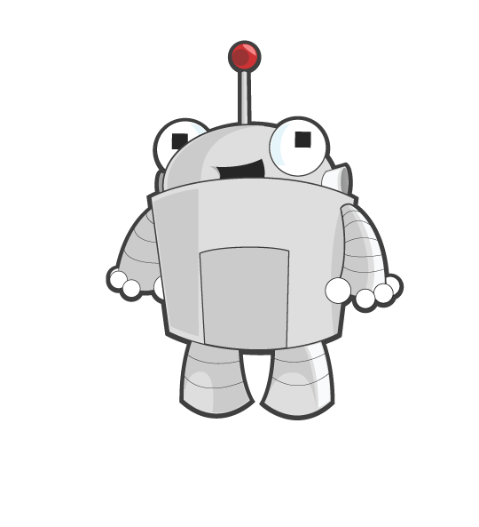
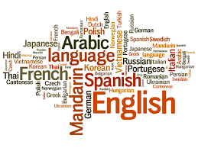
Features
Don’t underestimate
me human...
Smart ChatBot UI
Language Detection
Multilingual Translation
Built with Artificial Intelligence
Detect over 100 different languages
Supports up to 103 different languages
Image References: https://www.appjetty.com/wp/wp-content/uploads/2017/05/MagentoMultilingualTranslation.png
http://ux.prattsils.org/wp-content/uploads/2015/10/language-header.jpg
Notes:
Wan Ying.

Slide 3
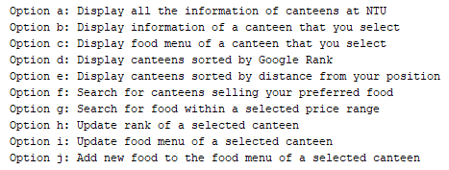
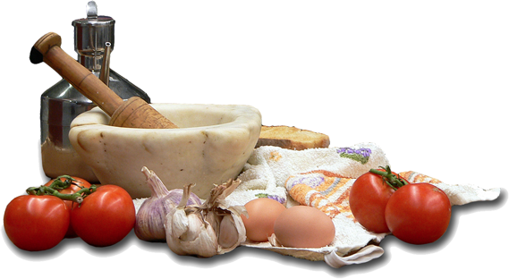
Features (cont’d)
12 canteens in NTU
Offers 10 Different services
Food menu, address, etc.
Notes:
Nurbakyt

Slide 4




Features (cont’d)
User Current Location Selection
Add / Update Food on menu
Update on canteen ranking
Object-Oriented Programming Methodology
Notes:
Nurbakyt.
PyGame to get user location -> User current location selection

Slide 5
FlowChart
Start
ChatBot
Food Recommendation Program
Database
Exit
Notes:
Fazli gonna talk about Flow Chart.

Slide 6
Techniques
Abstraction
Store data using data structures
Created different python files, each with its own purpose
Decomposition
Break down queries and call different functions step by step
Pattern Recognition
Canteens have same type of information
Use Object Oriented Programming and create separate classes
Algorithm Design
Searching and Sorting in Python
Notes:
Fazli talks about Techniques. Store data using lists, dictionaries, and classes for easier retrieval and modification of information in the database. Create different python files to store different functions for easier readability or when we want to update or retrieve information.

Slide 7
Team Workload Distribution
Fazli worked on main.py
Wan Ying worked on nlp.py (Chatbot) , PyGame in get_user_location(), main.py, database.py and management of SVC, GitHub Repository
Nurbakyt worked database.py.
Notes:
Each person talks about his/her own distribution.

Slide 8
DEMO
Notes:
Wan Ying gonna do demo. User can chat with the chatbot using simple words such as ‘hi’, ‘bye’, etc. Features of Chat Box (chatting and different languages) + (a, b) + (e) + (g) + (h) + (d) + (j).

Slide 9
Thank you for your attention. Any questions?

